Slide 1
Ex1
House
Chair
- chair: Chair
- House
- Chair
chairId: number
1
*
+ addChair () : Chair

Slide 2
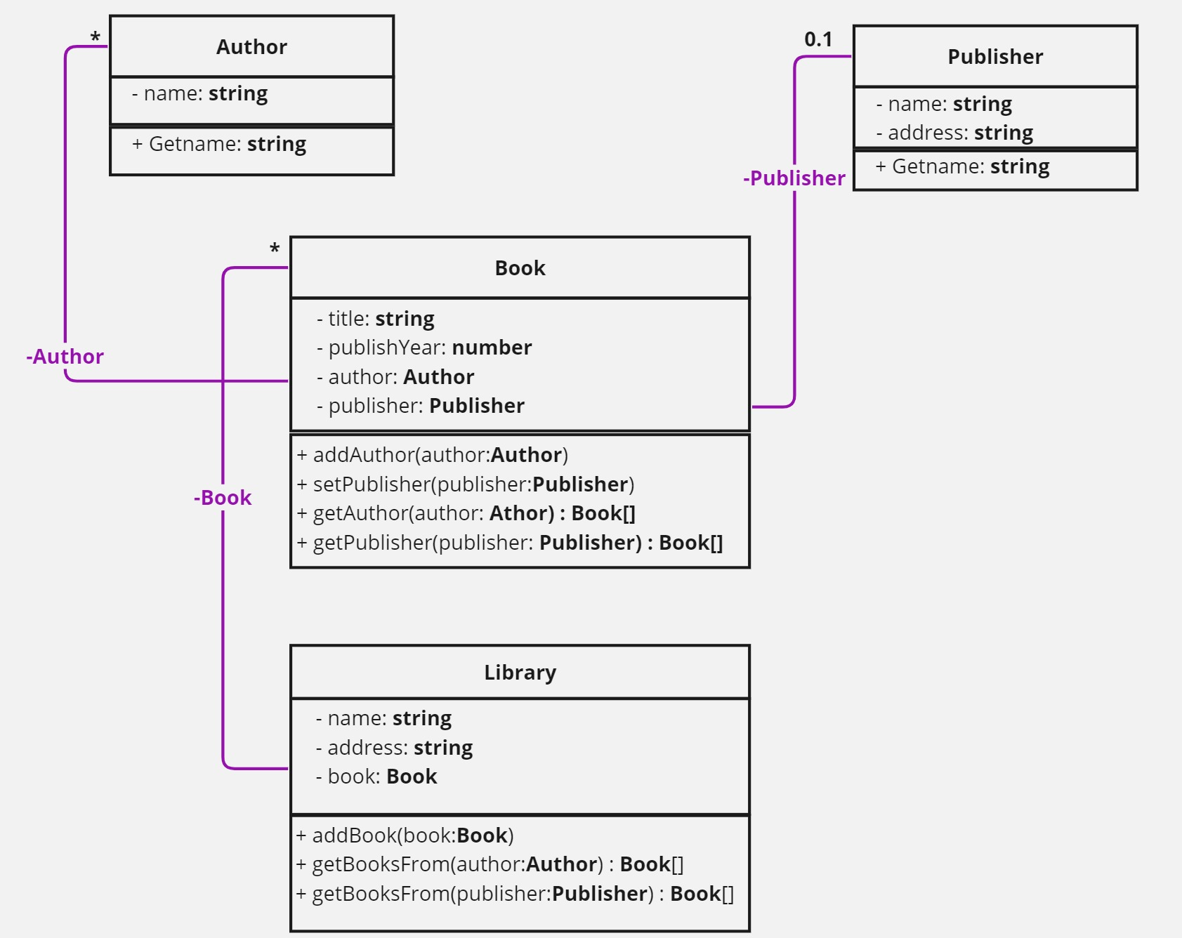
Ex2

